Slide 1
American Express Default Predictions
By: The Quagga Group
Ethan Silvas, Naomy Velasco, Karim Bouzina, and Jeff Crabill

Slide 2
Mission Statement
Develop a machine learning model that predicts credit defaults using real-world data from American Express to better manage risk in a consumer lending business.

Slide 3

Competition Description
“Predict the probability that a customer does not pay back their credit card balance amount in the future based on their monthly customer profile”
Credit default binary classification
Industry-size data
Potentially influence AMEX’s model

Slide 4
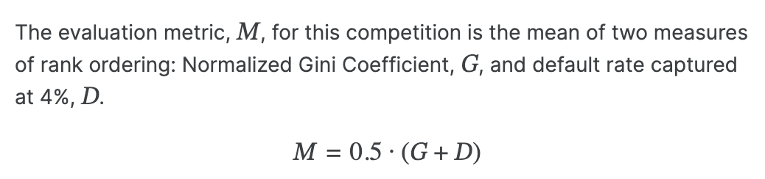
Evaluation
Calculates with test set predictions
Max possible score of 1.0
Top leaderboard score of 0.80977

Slide 5
Project Goals
Impute and encode our own dataset
Use new models like XGBoost and LGBM
Test techniques like dropout and regularization for neural networks
Score as close to 0.80 as possible

Slide 6
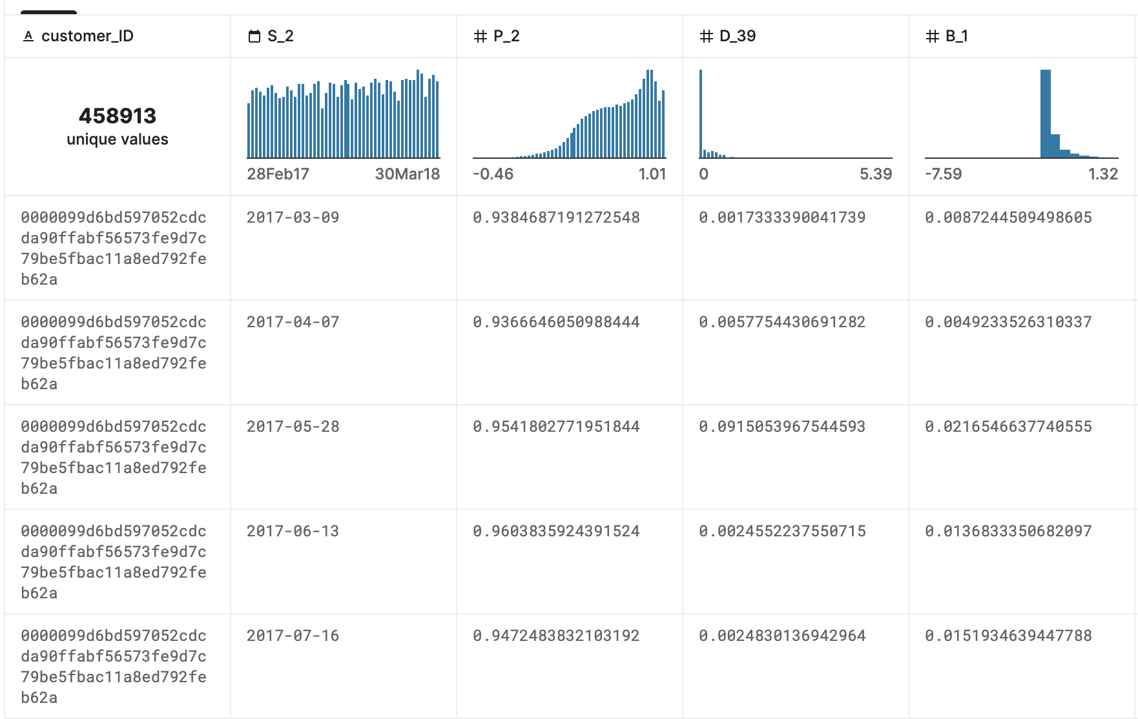
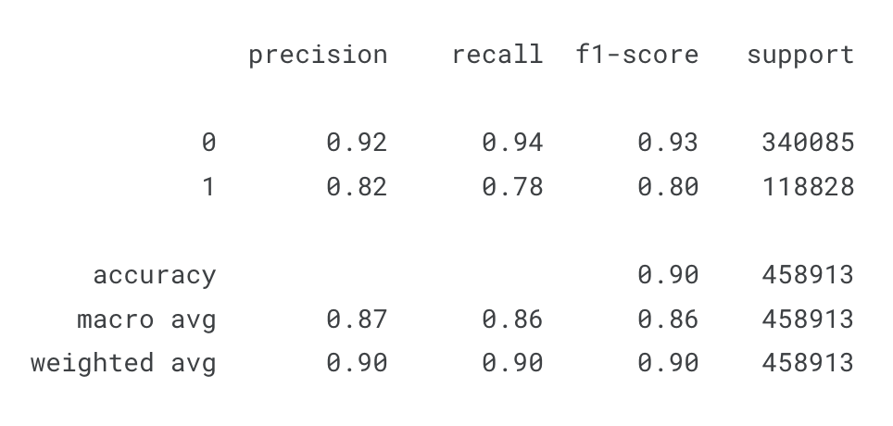
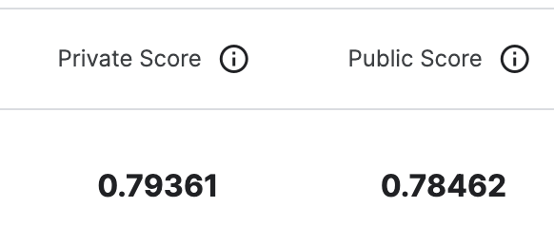
Outline
Collect
Baseline
Tune

Slide 7
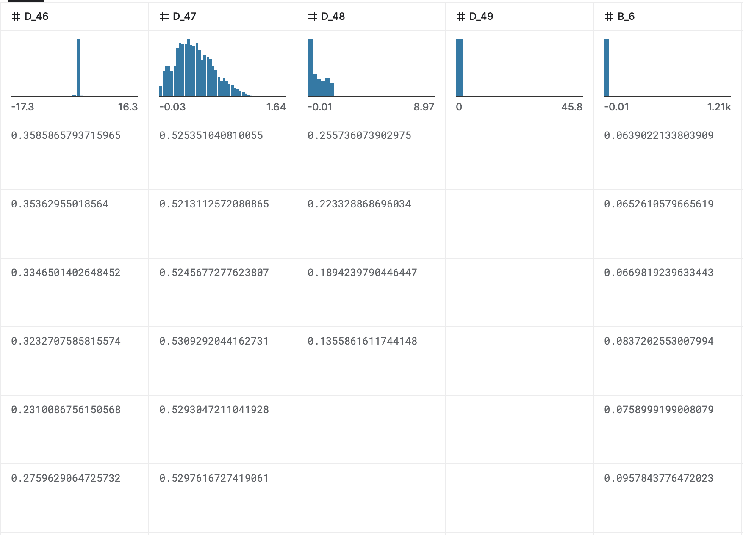

Data Collection

Slide 8
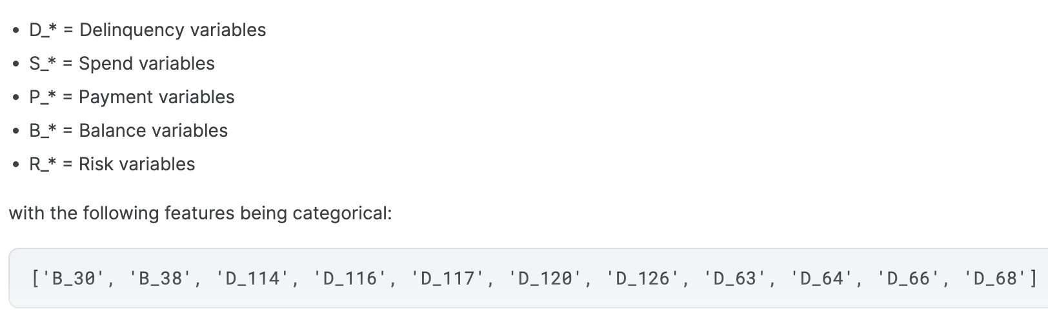
Data Collection: Features

Slide 9
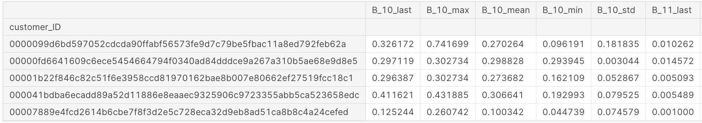
Data Collection: Aggregate

Slide 10
Data Collection: Methods
Original vs. aggregate
232 vs. 927 features
One-hot encode
Impute NaN values (already normalized)
Numerical = mean
Categorial = most common
TensorFlow pipeline
tf.Input()
float32

Slide 11
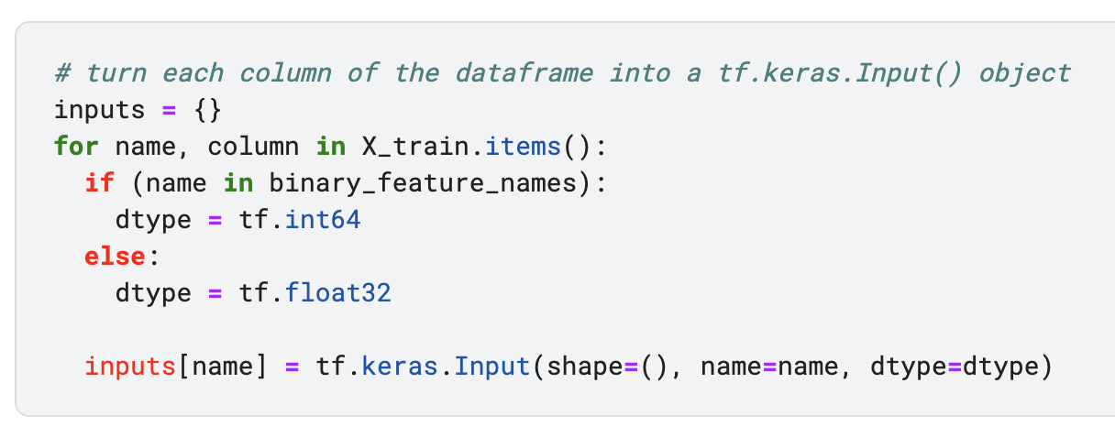
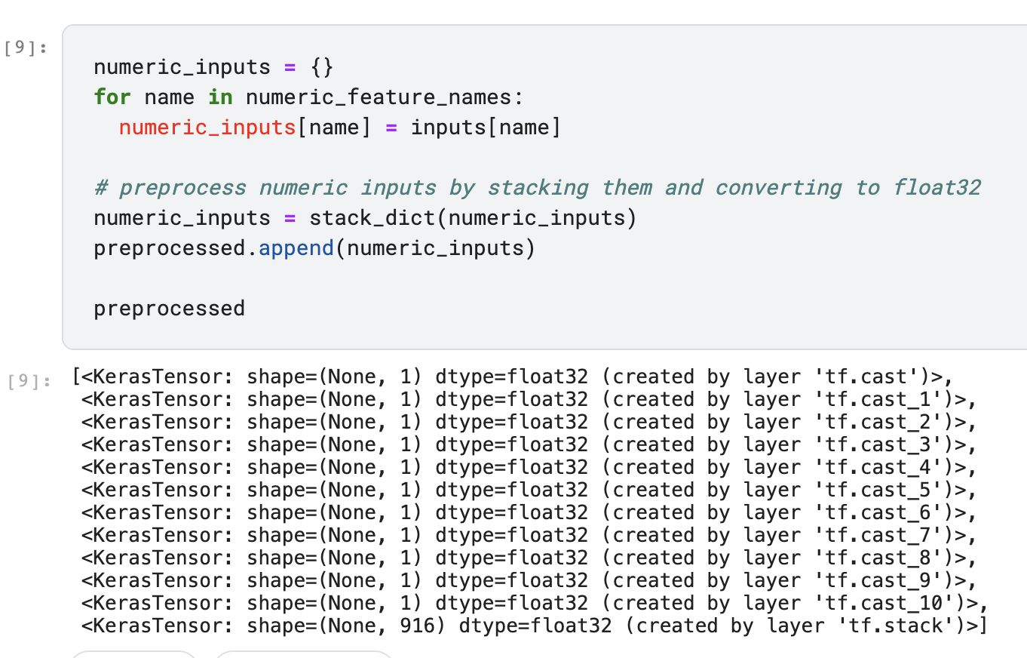
Data Collection: Code Samples

Slide 12
Baseline Models
Scikit-learn models
LogisticRegression
DecisionTreeClassifier
RandomForestClassifier
SGD Classifier
KNN Classifier
Shallow neural network (1 hidden layer)
LGBM
XGBoost

Slide 13
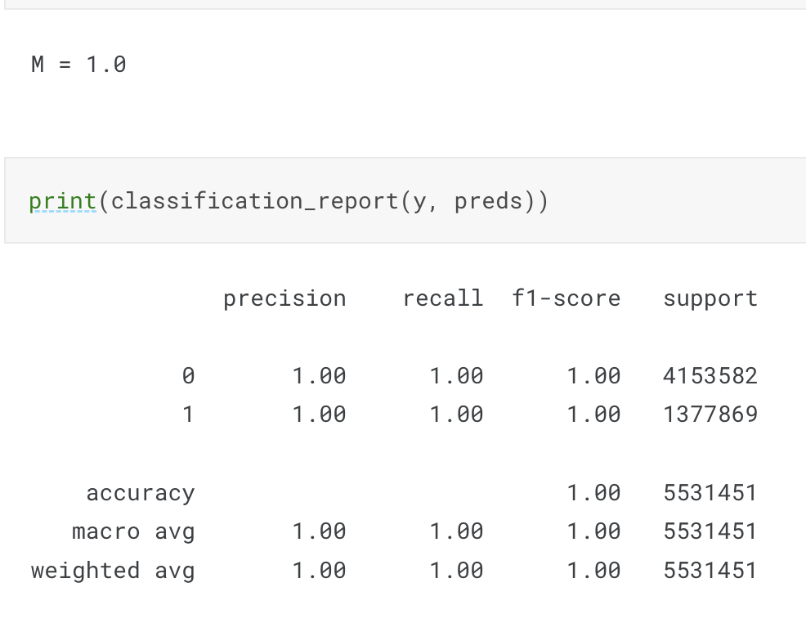
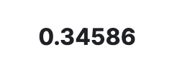
Baseline Decision Tree Classifier

Slide 14
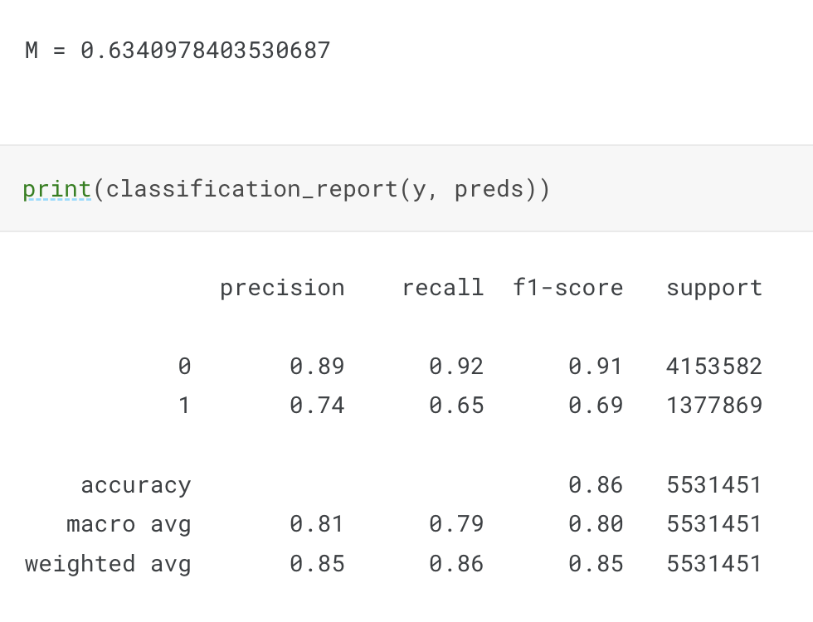

Baseline Random Forest Classifier

Slide 15
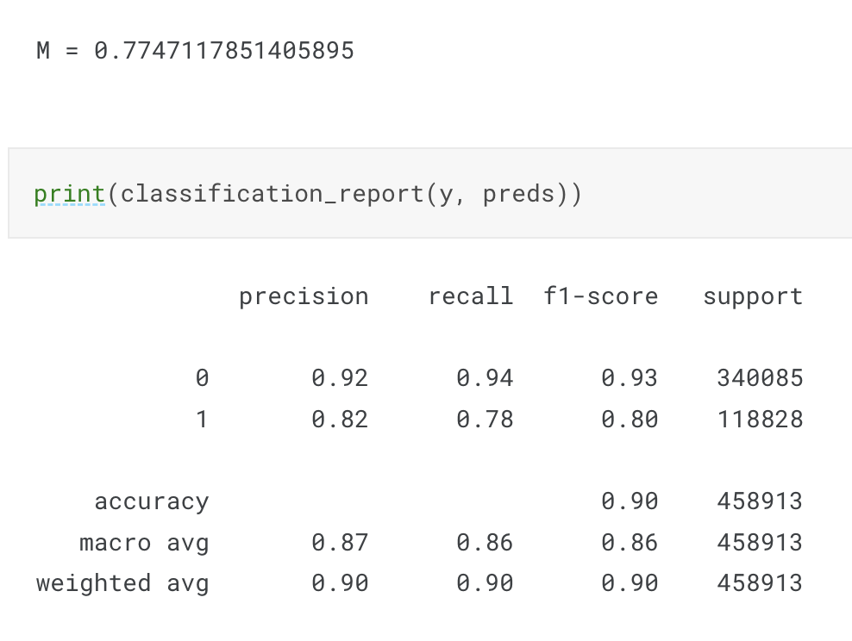
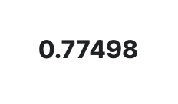
Baseline Logistic Regression

Slide 16
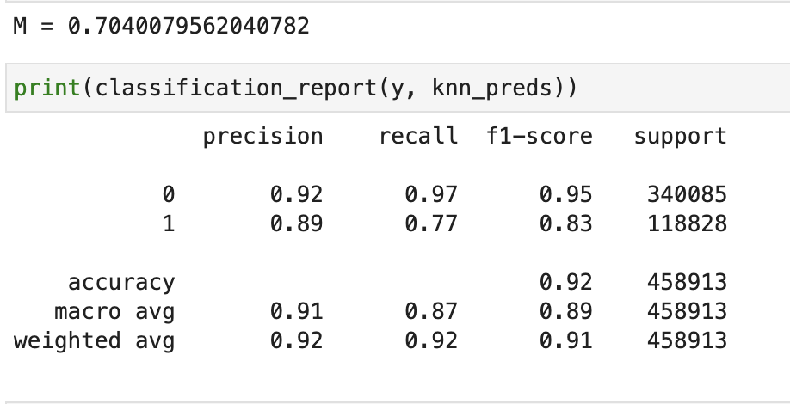
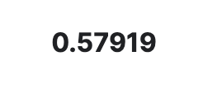
Baseline KNN Classifier

Slide 17
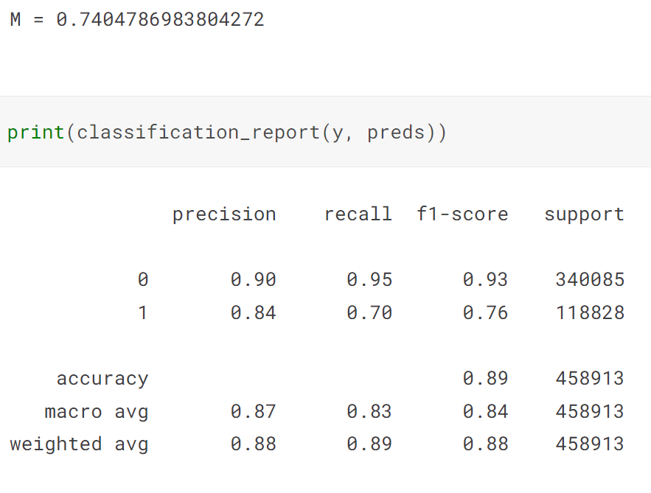
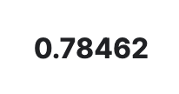

Baseline SGDClassifier

Slide 18
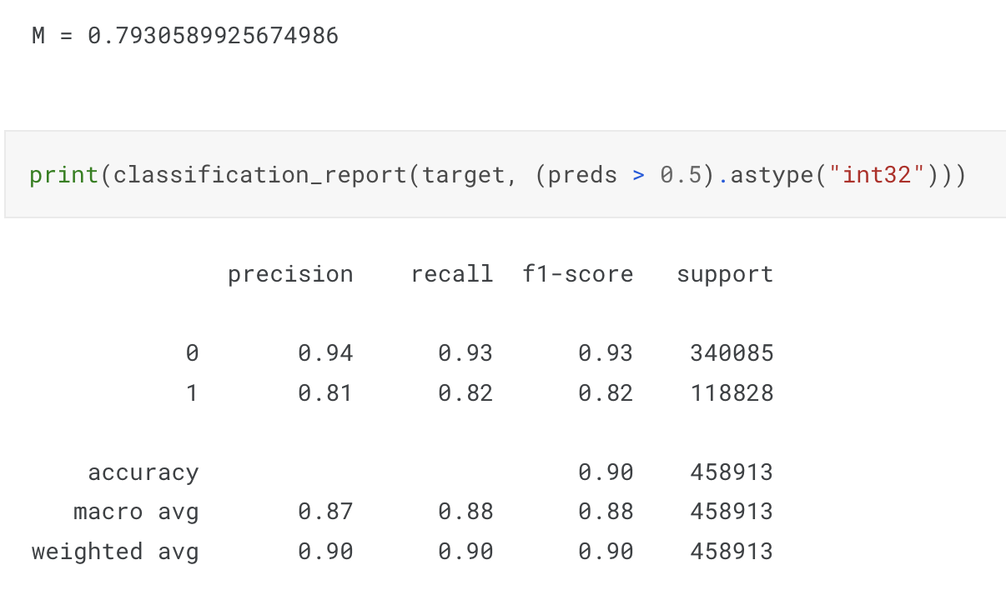
Baseline Shallow Neural Network

Slide 19
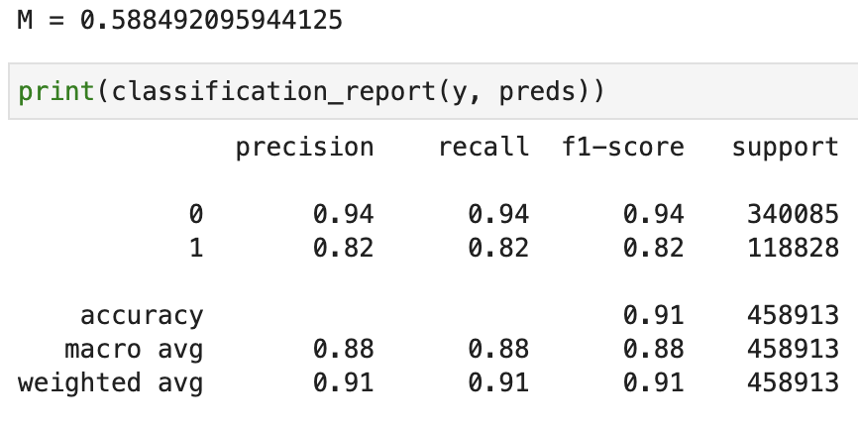
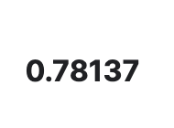
Baseline LGBM Classifier

Slide 20

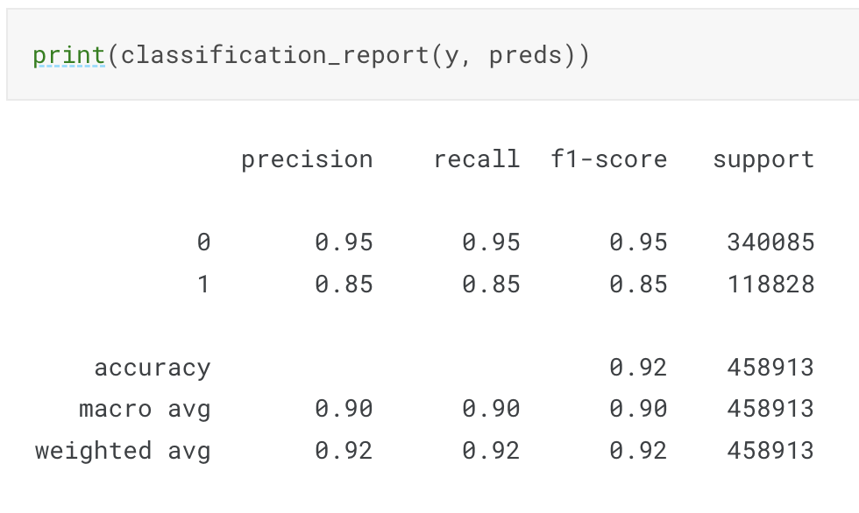
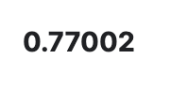
Baseline XGB Classifier

Slide 21

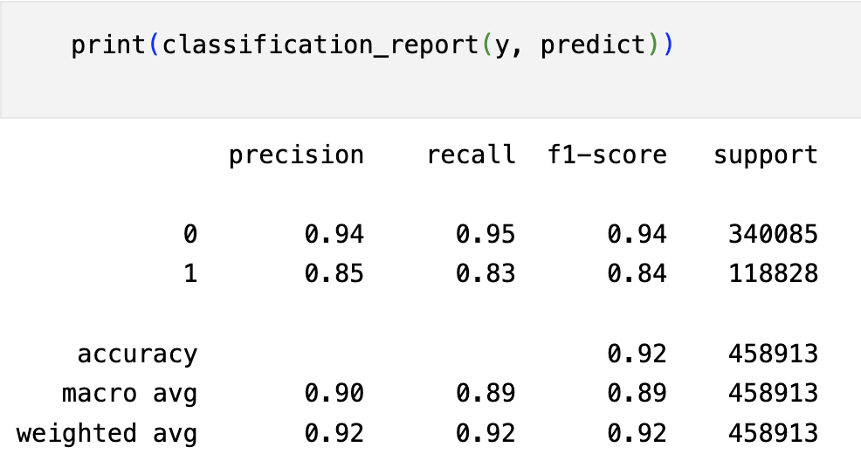

Baseline XGB Regressor

Slide 22
Baseline Models: Takeaways
Aggregate data was always better
90% accuracy “cap”
Easy to overfit
Try to beat 0.78462
How to improve by 0.01-0.02?

Slide 23
Tuned Models: Approach
Add validation set
Tune individual model hyperparameters
max_iter, max_depth, etc.
Neural networks
Activation functions
Number of layers and nodes
Optimizer
L1 or L2 Regularization
Dropout

Slide 24
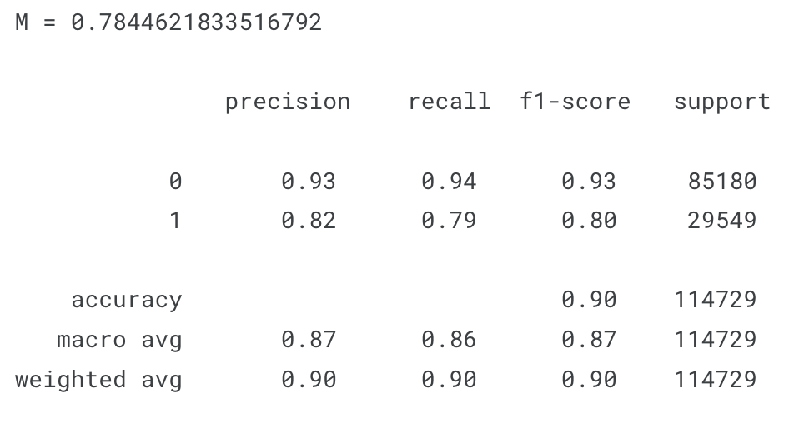

Tuned Logistic Regression
Validation size = .25
max_iter = 290
C = 100

Slide 25
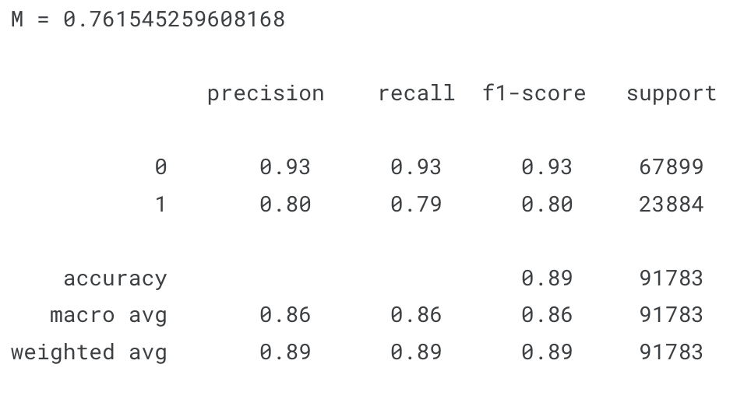
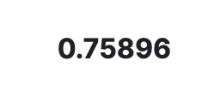
Tuned Random Forest Classifier
Validation size = .25
max_depth = 20

Slide 26

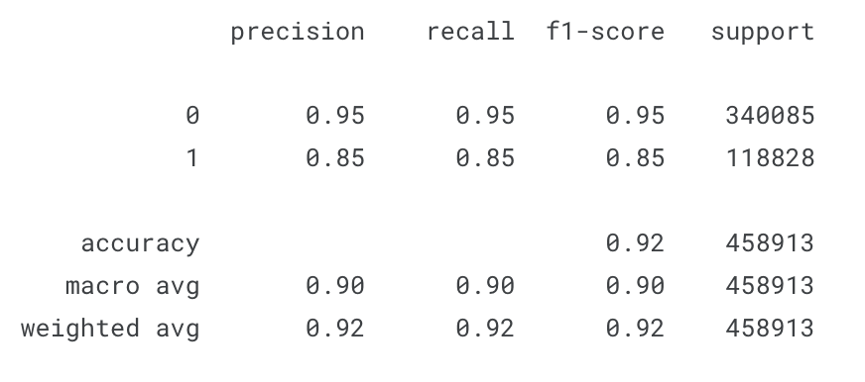

Tuned XGB Classifier

Slide 27
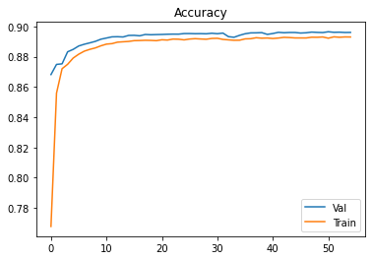
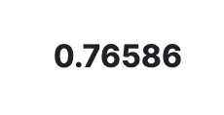
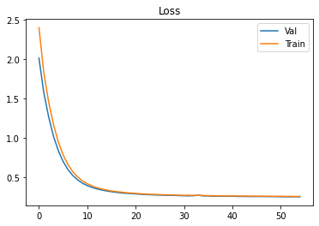
Tuned Shallow Neural Network
Validation size = .20
1 hidden layer, 116 nodes
Dropout = 0.1
L2 regularization = 0.01
55 epochs
50k batch size

Slide 28
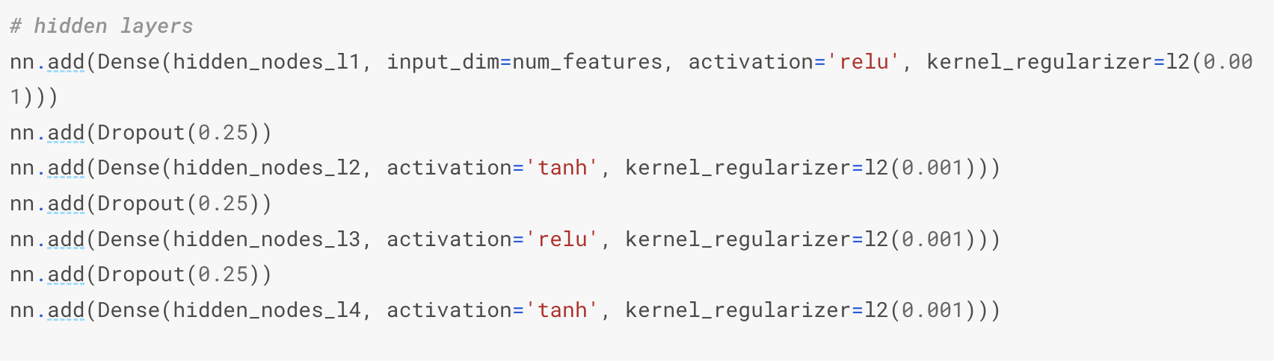
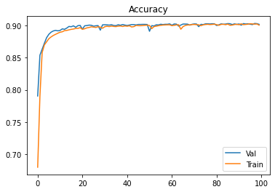
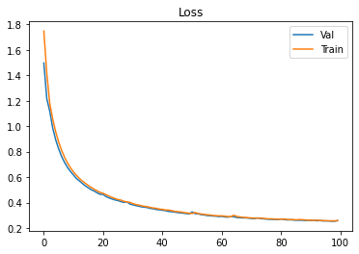

Tuned Deep Neural Network

Slide 29
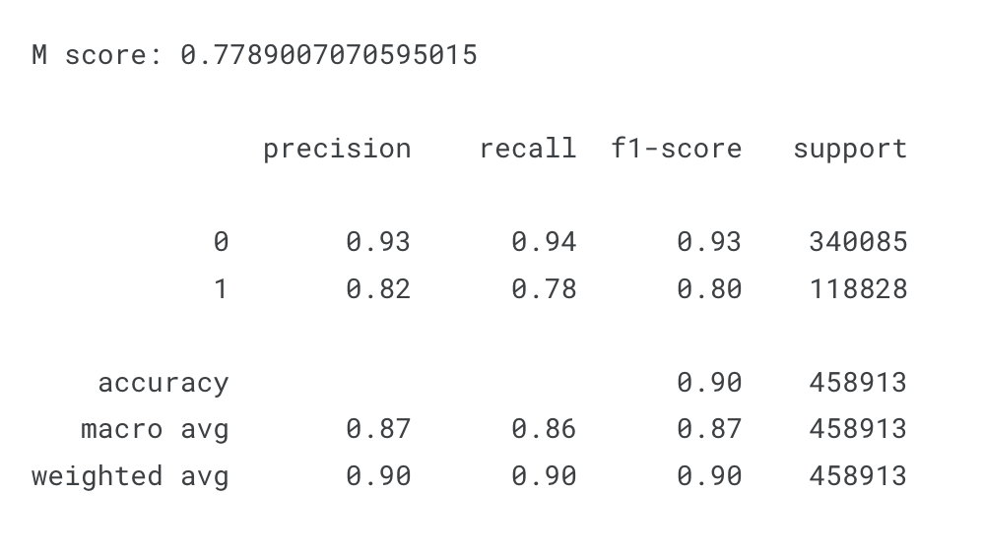

Tuned Logistic Regression + StratifiedKFold
Validation size = .25
max_iter = 290
C = 100

Slide 30
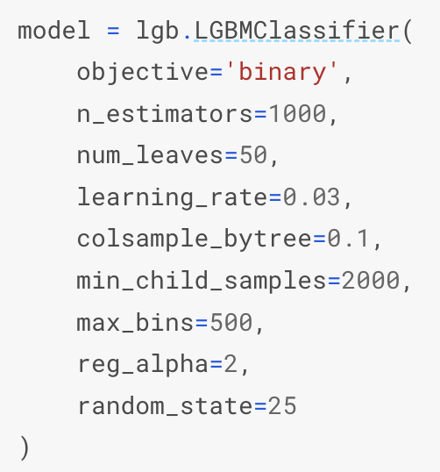

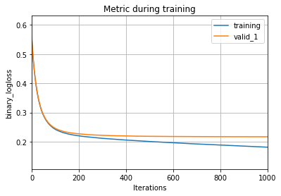

Tuned LGBM + StratifiedKFold

Slide 31
Results and Conclusions
Top model and score
LGBM + SKFold
0.79185
Balancing classes with SKFold improved performance
More tunings/complexity != better performance
Importance of data collection, imputing, encoding
Look out for really good training performance

Slide 32
Project Difficulties
Memory constraints
Long training times
Dealing with NaNs
Trying to improve by 0.01-0.02
90% accuracy “cap” and overfitting

Slide 33
Next Steps
Keep tuning hyperparameters
Try models that can handle NaN values
Label encoding instead of one-hot
Try more variations of Dropout/Regularization
AWS models
Auto generate hyperparameters (ex: RandomizedSearchCV)

Slide 34
Thank you!

